Slide 1
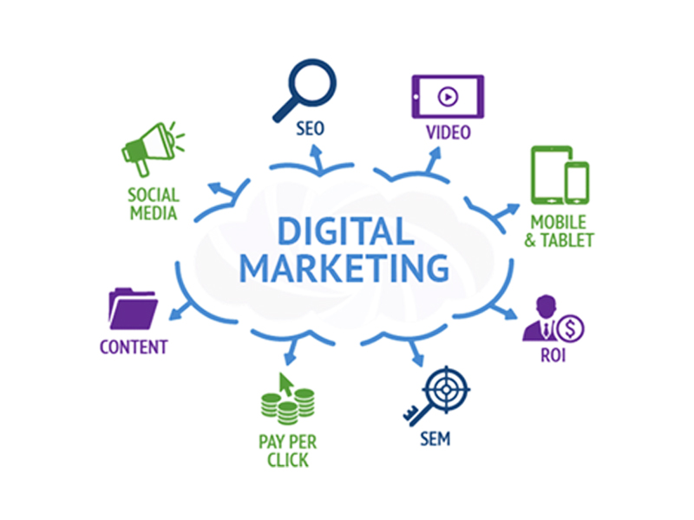
Maximizing ROI From Digital Marketing Campaign
Submitted By-
Tushar Nigam
Guided By-
Phaneendra Akula

Slide 2
Approach
Digital Marketing Analytics
Business Understanding
Business Case
Data Collection
&
Understanding
Clustering
&
Regression
Evaluation

Slide 3
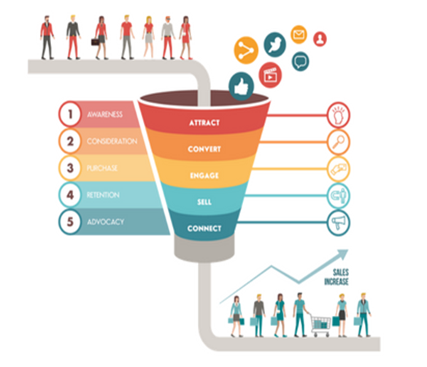
Digital Marketing
Digital marketing is the marketing of products or services using digital technologies on the Internet, through mobile phone Apps, display advertising, and any other digital mediums.

Slide 4
Digital Marketing Analytics
Which Digital
Marketing
Platforms are
working well?
Which Campaigns
are doing well?
01
06
Digital marketing analytics
02
What Ad Types
are working well
for Organisation?
Which Geography
can drive more
Revenue?
05
03
04
Which Keyword
has better
Strenth?
How to make
campaign ROI
driven?

Slide 5
Business Case
A Healthcare company is campaigning for its product from last 9 months. The campaign involves advertisement on different Media Types(Channels) like Social Media, Yellow Pages, Telephonic Campaigns, etc. All the media types have a cost associated to them for advertisement, hence a huge investment is being done on the campaigning. However, the ROI are unsatisfactory.

Slide 6
Problem Statements
Get an insight on the Customer behavior on different media types.
Get an insight on Revenue generated from different media types.
Identify the group of well performing Ads in a media type which can act as a model for furture campaigns.
Identify the key drivers affecting the Revenue, so that necessary actions can be taken on them to improve the Revenue.

Slide 7
Data Collection & Preparation
Media Types (Data Sources):
Gmail
Amazon
Facebook
Youtube
Display
Yahoo
Yelp
YelloPages
CityGrid
Seahawk
SpotX
Videoamp
Paidsearch
DAX
Pandora
Consolidate data of 36 weeks for each Media Type
Perform SQL Queries for aligning data from different sources.
Weekly Data From Different Media Types (Data Sources)
Import the data into SQL Database
Export Consolidated Dataset for Exploration and Analysis

Slide 8
Data Understanding
30K + Observations
Time Frame: 9 Months
15+ Sites
12 Variables
10+ Media Types

Slide 9
Variables
Clicks
No. of times the ad was clicked by the user.
Impressions
Revenue
No. of times the ad was displayed on the page.
Measurement of how much revenue your activities on social media
01
08
02
Units
Spend
07
Amount spent on Pay per Click or Cost per Click
03
The number of Units that were successfully ordered
06
04
05
Order_Completion
Calls
Whether the order was placed or not.
No. of calls to Customer (if any).
Cart_Entry
The number of Units that were put into the cart.

Slide 10
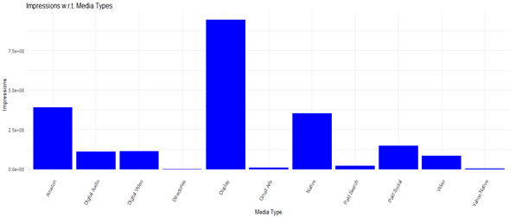
Data Exploration (Impressions)
Media Type getting highest Impression:
Display.
Media Type getting lowest Impressions:
Directories.

Slide 11
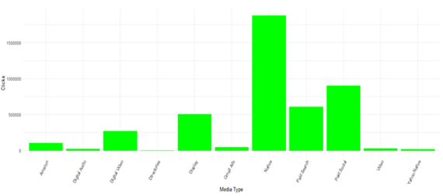
Data Exploration (Clicks)
Media Type getting highest Clicks:
Native.
Media Type getting lowest Clicks:
Directories.

Slide 12
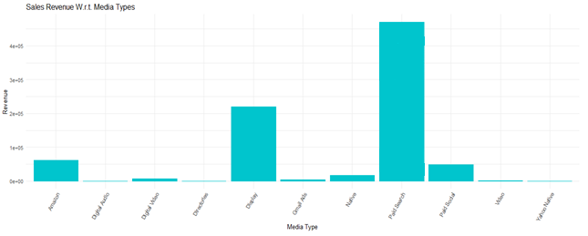
Data Exploration (Revenue)
Media Type generating highest Revenue:
Paid Search
Media Type getting lowest Revenue:
Yahoo Native

Slide 13
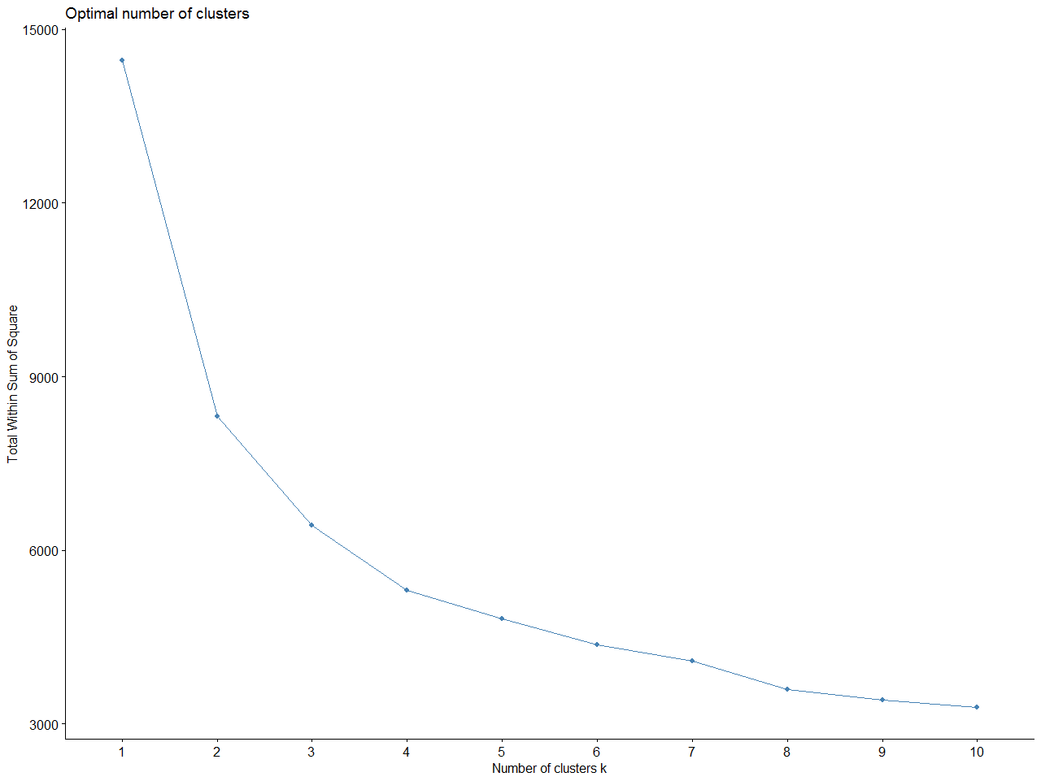
Clustering the Ads
Objective : Cluster the Ads with similar behaviour of metrics so that the best performing group of ads could be discovered, and in future campaigns, similar ads can be designed(in terms of location, format, etc.)
Media Type : Facebook
Obtaining the best cluster : Once the clusters are created, we can sort the clusters based on the average revenue they generated.
Clustering Technique : K-Means
Optimal Clusters : 4

Slide 14
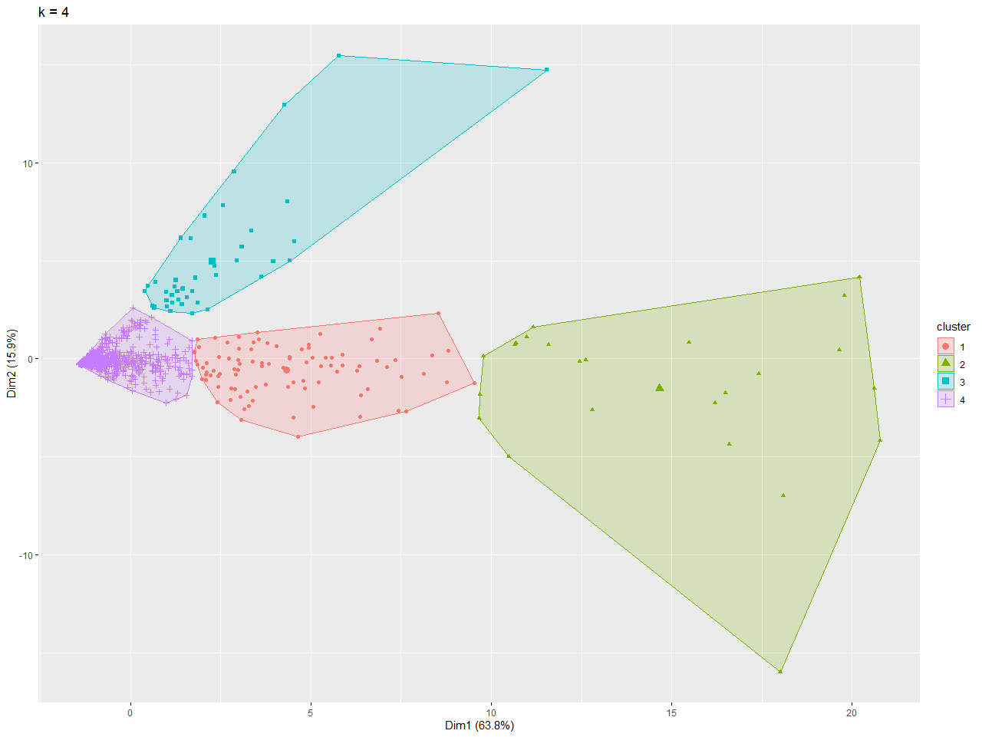
Clustering
Cluster | Type | Profit Generation
Green | Platinum | 47.5%
Red | Gold | 31.6%
Blue | Silver | 11.2%
Purple | Bronze | 9.7 %

Slide 15
Clustering Recommendation
Cluster in Purple is the lowest revenue generating cluster. The design, type, keywords and placement of ads in these cluster should be investigated and minimal Spend has to be done on those. Ideal scenario is to move these ads towards the Green Cluster
Cluster in Green is the highest revenue generating cluster among all others. Hence, the design, placement and keywords other properties of these ads should be studied and taken as an inspiration for the ads that will be used in future campaign runs.

Slide 16
Regression
Objective : Regression Analysis for identifying the key drivers of Revenue.
Data : The ads that were present in Green Cluster.
Dependent Variable : Revenue
Technique : Linear Regression
R – Square: 0.83
Adjusted R-Square: 0.84
Model Parameters

Slide 17
Regression Analysis Interpretation
Based on the Regression Coefficients, Primary key drivers for Revenue are :
Clicks
Impression
Order_Completion
With increase in the above variables the Revenue Increases.
Impressions
Clicks
Order_Completion
Key Drivers

Slide 18


